Slide 2
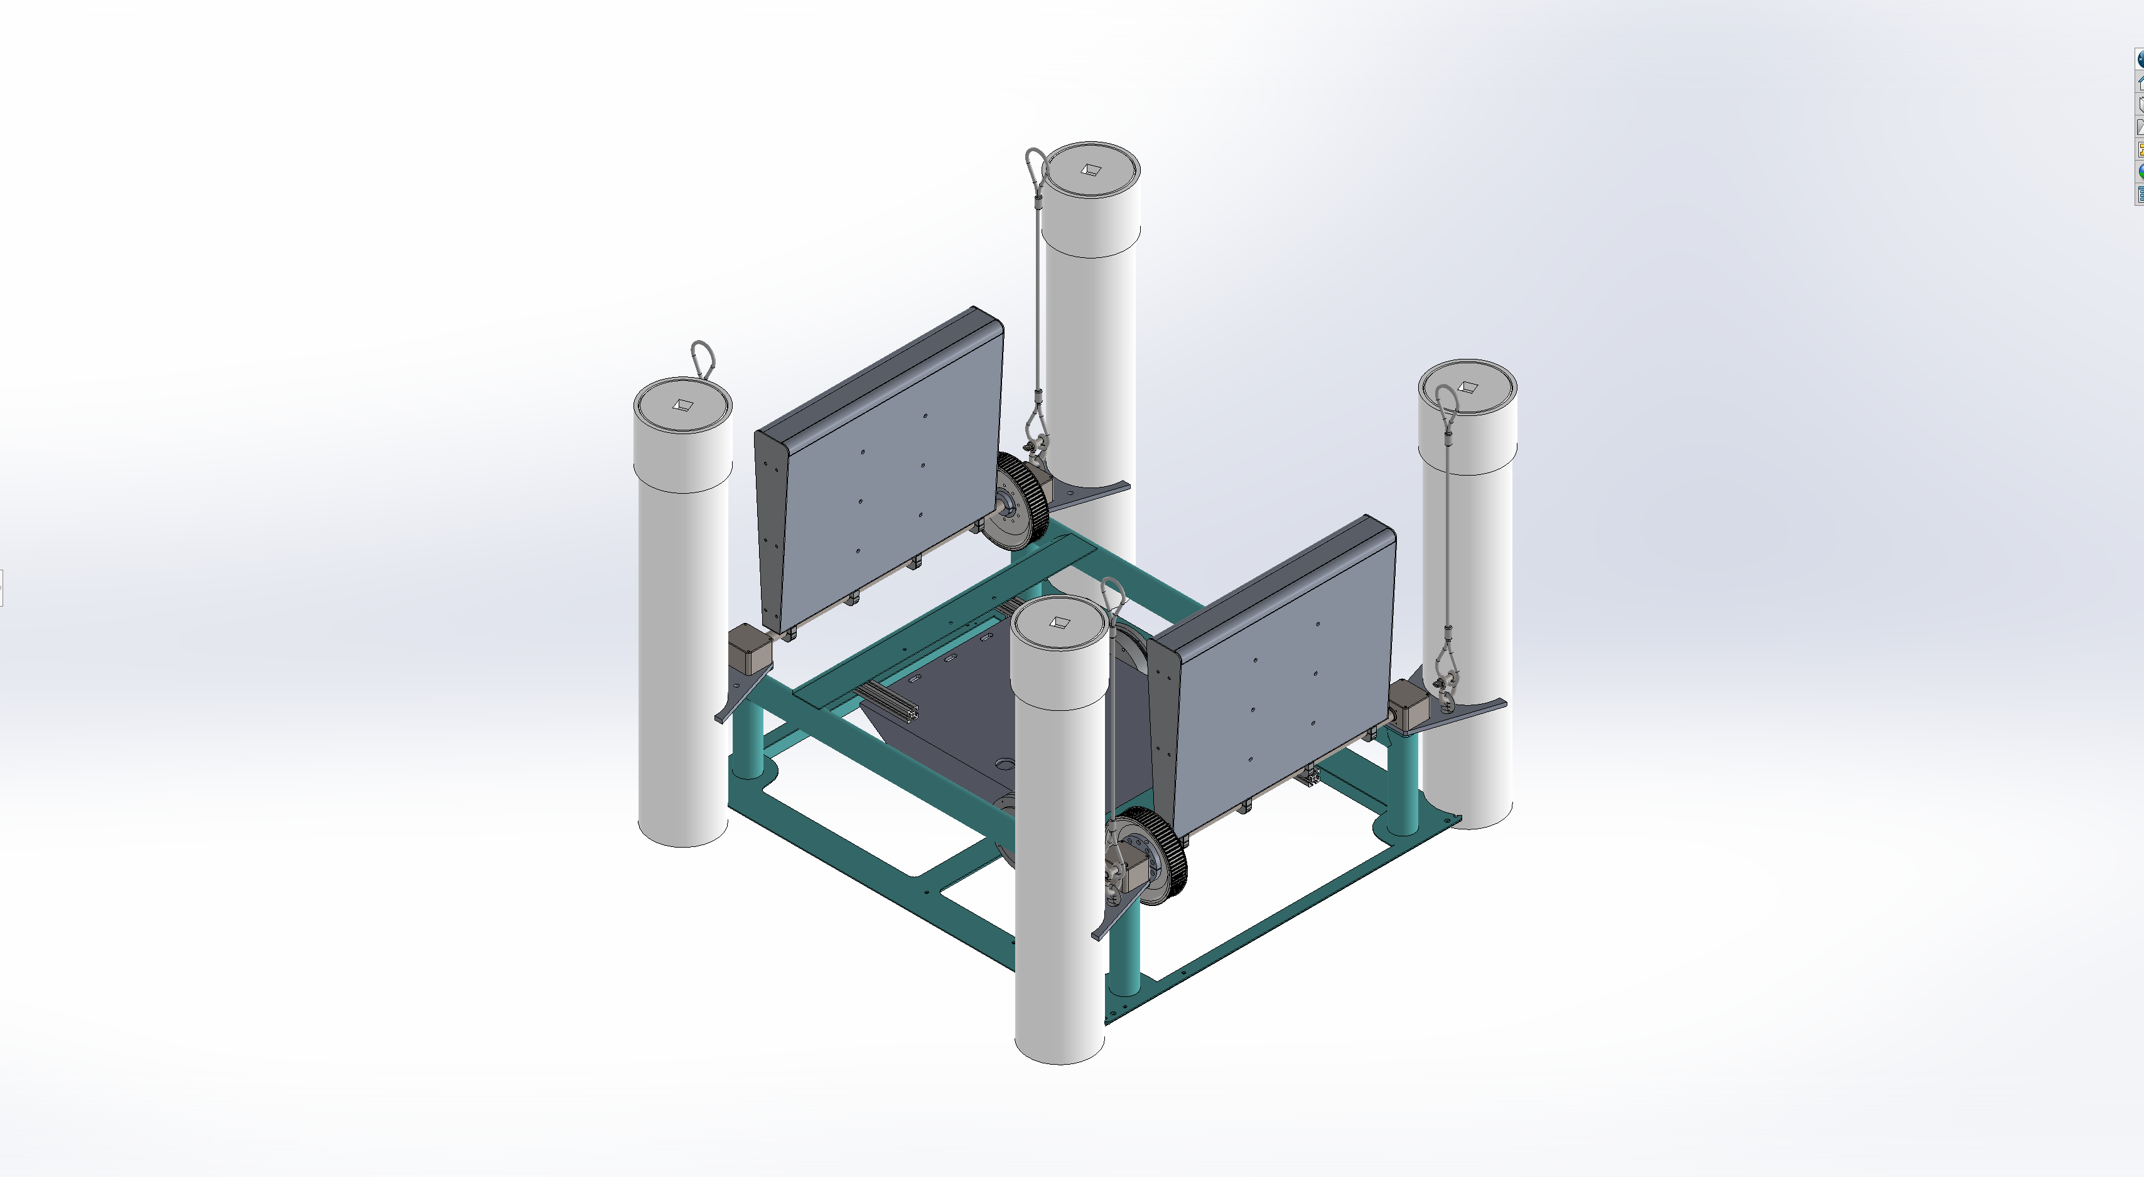
Incident wave direction
Bow
Starboard
Aft
Z
Y
Port
X

Slide 3
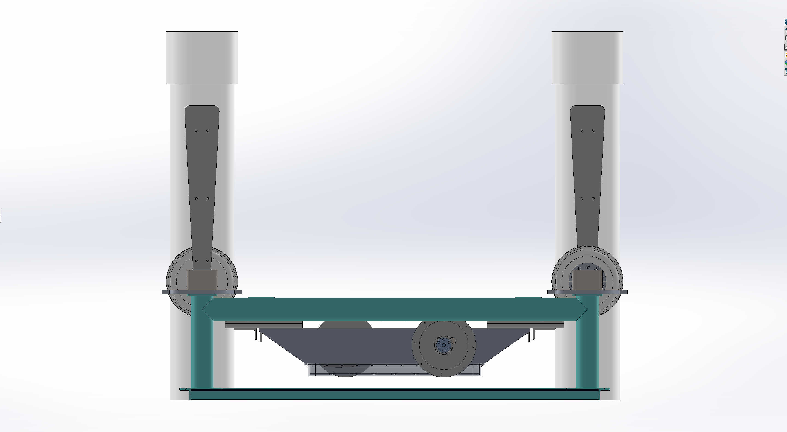
Bow
Aft
+flap.bowFlap_deg
+flap.aftFlap_deg
Z
+motor.bowTorque_Nm
+motor.aftTorque_Nm
+motor.bowPos_rad
+motor.aftPos_rad
X
Cycling low power resets position zero

